Slide 1
Does It Pay to Attend an
Elite College?

Slide 2
(front door … not side door)

Slide 3
TL;DR Version
Yes. There seem to be large and durable returns to graduates of elite universities and colleges.
Those benefits increase over time.
“Devils in details.”
You probably should not base your child’s choice of college on the basis of any one study, or even this talk.

Slide 4
College Costs = What You Sacrifice By Attending
Costs
Incremental resources required to go to college
Tuition and fees;
Less grant-in-aid
Only some (or none) of Room & Board;
Net Value of What You are Giving Up
(e.g. military service, a job, traveling the world, etc.)
Costs Vary Dramatically by Sector and Student

Slide 5
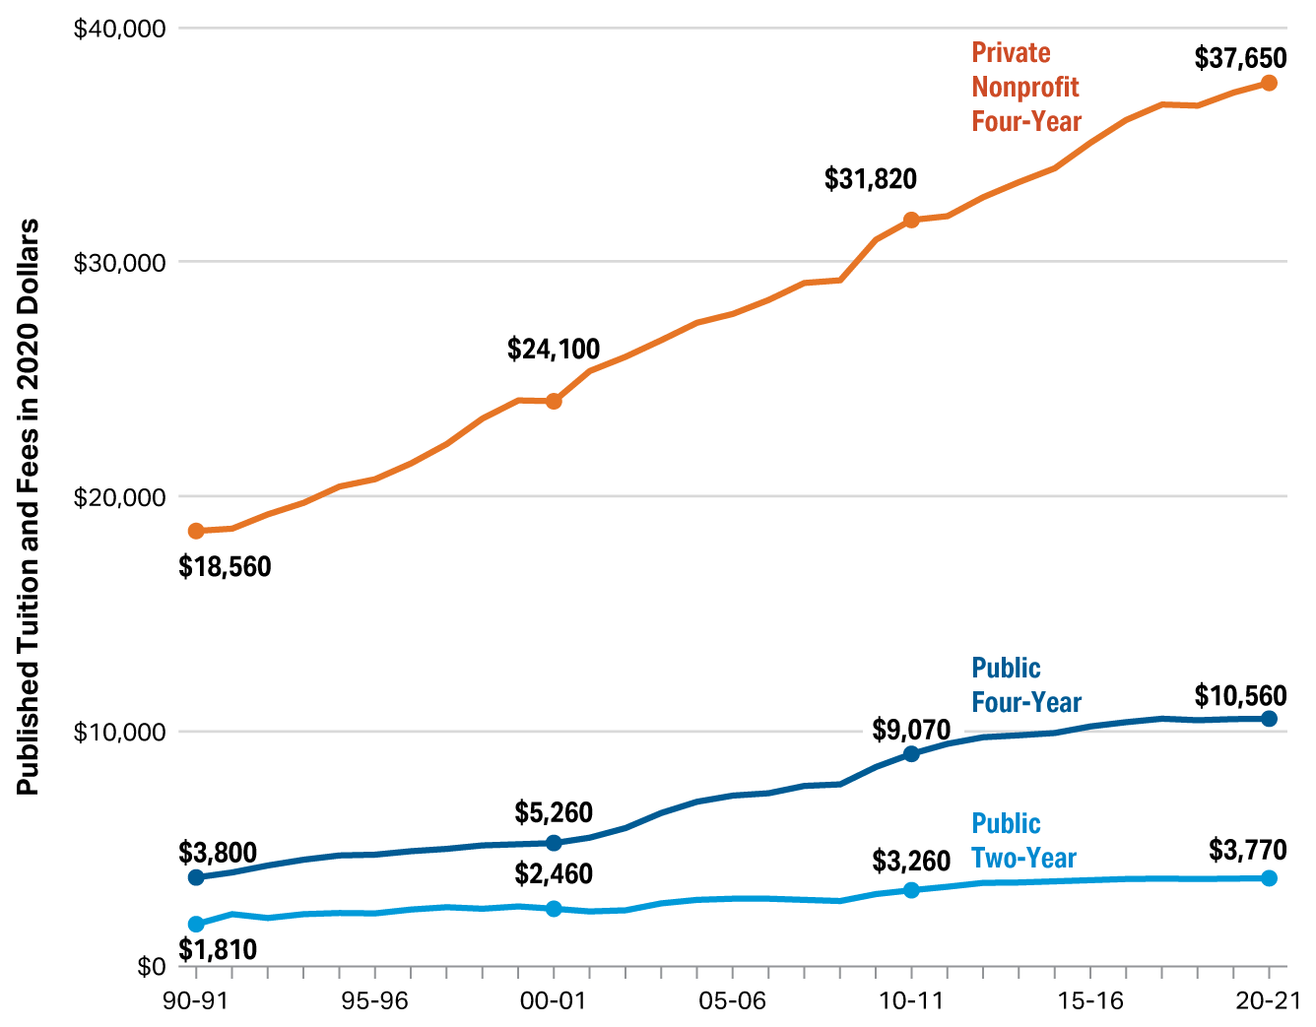
Source: College Board, 2021
Sticker Shock?
“Real” Dollars
…
I.E. More than twice the rate of inflation

Slide 6
Burden of College Pricing Costs as a Share of Median HH Income
1990
Median Household Income: $57,000
Private Tuition and Fees: $18,560
Cost as Share of HH Income: 33%
2020
Median Household Income: $68,000
Private Tuition and Fees: $37,650
Cost as Share of HH Income: 55%

Slide 7
The Burden, Reconsidered
Household incomes increase at different rates:
20th percentile ( $30k) → 20% growth since 1990
80th percentile ($100k) → 60% growth since 1990
99th percentile ($540k) → 110% growth since 1990
99.5th percentile (~$1.0M) → 170% growth since 1990
99.9th percentile (~$1.6M) → 333% growth since 1990
Average Sticker Price at Privates Masks Diversity
In-state Publics: $8,000 (e.g. Cortland, Plattsburgh)
In-state Flagship: $10,524 (e.g. Buffalo)
Out-of-State Elite Public: > $50,000 (e.g. UVA, Michigan)
At “elites”, the “all-in” cost is closer to $80,000
U of R Next Year: $79,654; 100% increase over the apx $39,000 they charged in 1990.

Slide 8
In Other Words
Incomes at High End Have Kept Pace (or Better) With the Rise in College Costs
For Households Below 90th Percentile, College Costs Have Risen Faster Than Income
The “Top 1%” Contains 1.4 million tax-filers with over 2 million children
There are Less Than 200,000 Freshmen Seats at the Top 50 Elite Colleges

Slide 9
Why Does College Cost So Much?
A Different Talk …
… for a Different Day

Slide 10
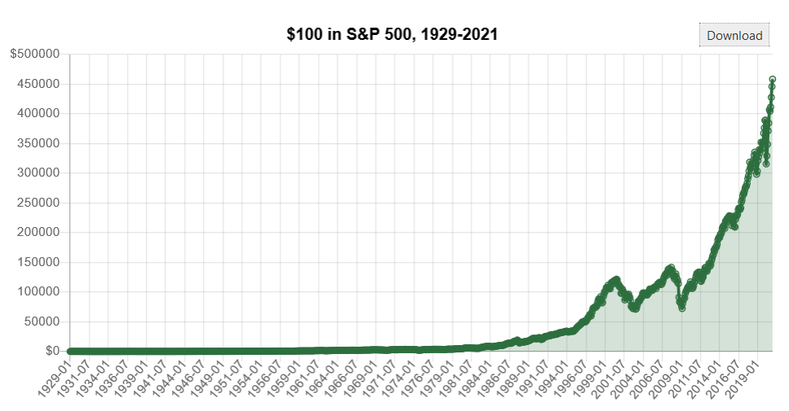
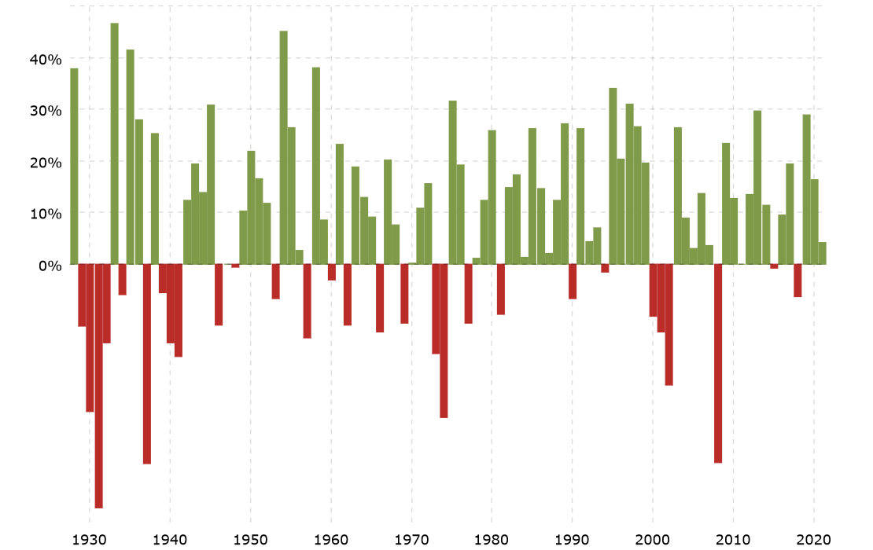
Is The Investment Worth It? → Stocks.
Annual Average Returns in Stocks: A risky 9.6% per year
It is a 6.4% real return (controlling for inflation), double in 11 years
29 years with NEGATIVE returns (> every 4 years)

Slide 11
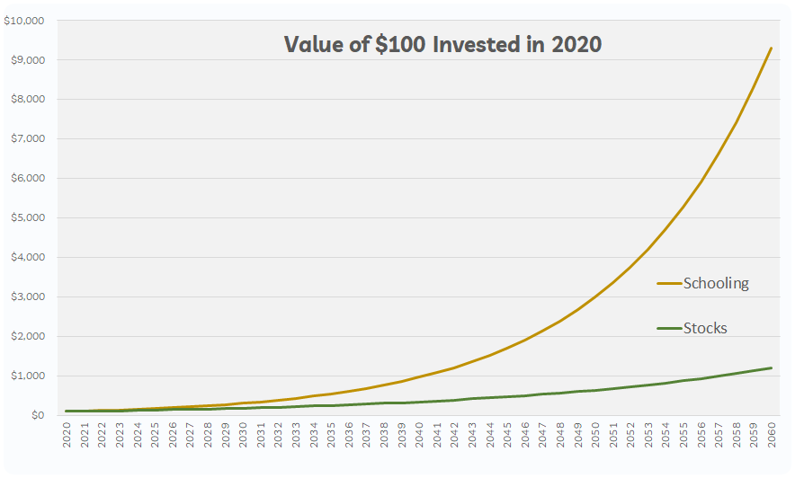
Is The Investment Worth It? → Schools.
Annual Average Returns: 11-14% per year
Double your asset value every six years
$100 invested today yields $9,000 at end of career vs. $1,200 in stocks
Zero years with negative returns

Slide 12
Peel Back the Sticker
Sticker Price vs. What You Actually Pay
Publics
2006 Sticker vs. Actual COA: $16,350 vs. $12,180
2021 Sticker vs. Actual COA: $22,180 vs. $14,850
Privates
2006 Sticker vs. Actual COA: $38,830 vs. $26,220
2021 Sticker vs. Actual COA: $50,770 vs. $29,910

Slide 13
Earnings Advantages of “Average” College
Median Weekly Earnings by Educational Attainment
High School Grads $750 per week
College Grads $1,250 per week
67% premium, each year
Over $1,000,000 more earned over working life
Ignores non-wage compensation, option values, insurance
Professional/Doctoral Grads $1,900 per week
Another 52% premium, each year, over college grads
Another $1.4 million earned over working life

Slide 14
Other Advantages of “Average” College
College Grad → Less chance of job loss / search fail
Pre-COVID Unemployment Rates (and 2010 Recession Peak)
High School Graduates → 3.7% (15%)
College Graduates → 2.2% (4%)
Professionals/Drs → 1.0% to 1.5%
College Grad → More job satisfaction
College Grad → Better health outcomes
College Grad → find partners with more education, less likely to divorce

Slide 15
Average Shmaverage
OK, great.
Those are average benefits accruing to “average” students over “all” colleges.
There is no average college.
There is no average student.
College “returns” depend crucially on:
Who you are
Where you go

Slide 16
Average Shmaverage
Credit Constraints: Equally qualified but lower-income students 16 percentage points less-likely to enroll in college than higher-income students
Navigating Financial Aid: Barrier to all students. Studies show that simply offering help on FAFSA increases enrollment and retention by 25%
Returns Vary by Occupation and Major: E.G. Careers in STEM return over $2 million more over career than career in Health Support

Slide 17
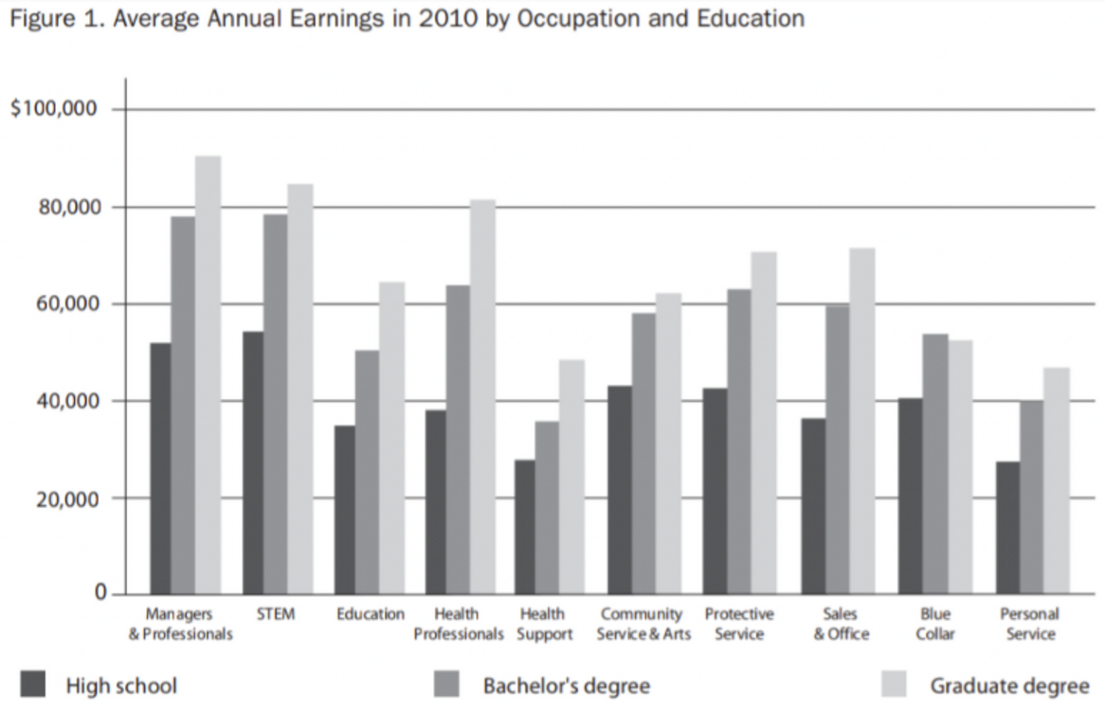
Occupational Gaps > College Premium

Slide 18
College Premium Varies by Student
Baseline: College “bump” is apx. 70% higher annual earnings each year. But “who gets this?”
Higher Earners Benefit More: Gap between x^{th} percentile College Grads vs. HS Grads increases in x
E.G. College grads in 90th percentile of earnings (where many of you will end up) earn DOUBLE that HS grads in 90th percentile of earnings
Returns to Marginal Students: 4-7% per year at CC, maybe 6-9% at 4-year college (remember only 67% of HS grads go to college, and only 60% of them finish)
Athletes: Earn 4% more than non-athletes (apx $2,600 more per year). Why? Clustering into finance.

Slide 19
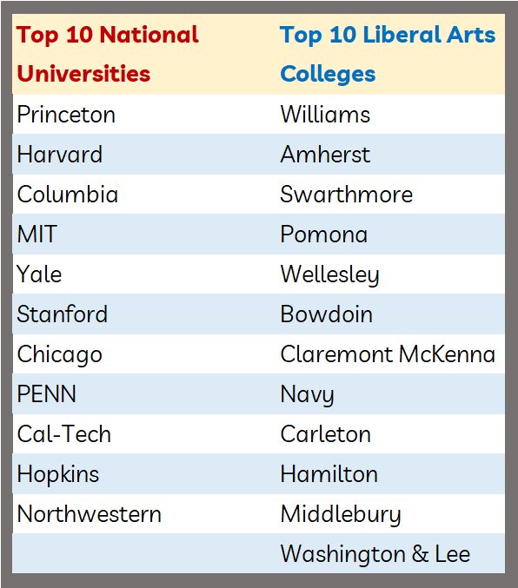
OK, OK! What About the “Elite” Colleges?
Elite?
4,000 total colleges
Only ~ 260 National Research
Only ~ 250 Good L.A. Schools
Reality
About top 2-3% of schools
Maybe Top 50 Research
Maybe Top 25 Liberal Arts
Expend per student proxies quality

Slide 20
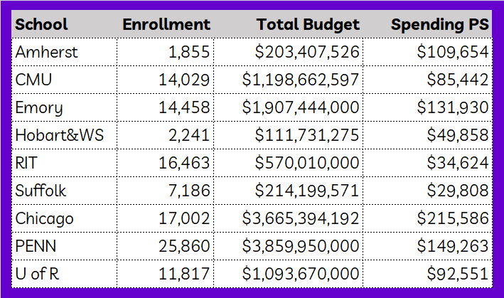
What Determines School Quality? → $$$
Reference: Pittsford Schools, among best in US, spend ~$20,000 per st.

Slide 21
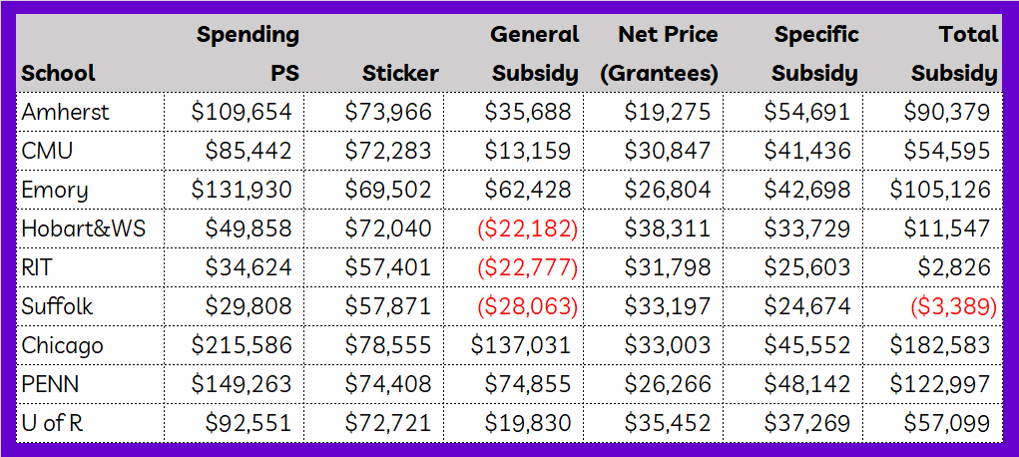
What Determines School Quality? → $$$
Quality
Price Discrimination
Crafting a Class

Slide 22
Why Are the Stakes So High?
Elite Colleges are More Selective Today: “I would not have gotten into Amherst had it been this selective back in 1992!”
Over Half of Colleges are Less Selective Today: Only the top 400 schools today are as “good” as they were 50 years ago
Why? Resorting of Students Across Colleges
Despite #seats at top colleges keeping pace with enrollment growth
Many elite students used to stay close to home, now cluster away
Lower travel costs; Lower information costs
Schools have easier time identifying talent
All students applying to many more schools at once (60% apply to >4)

Slide 23
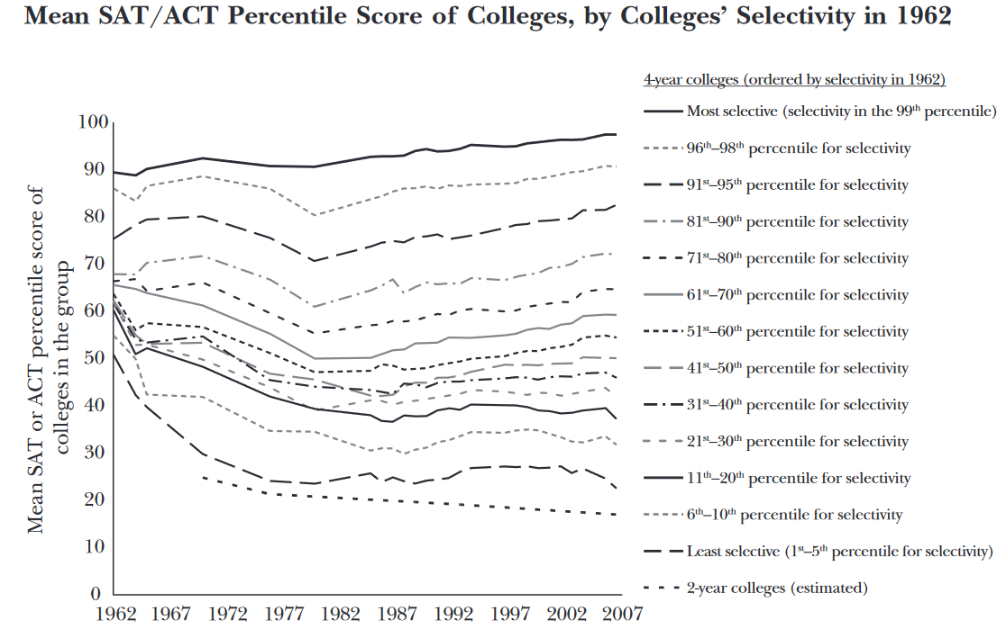
Why the Stakes Seem So High: Stratification
Illustration:
Average SAT difference between “worst 5% and best 5%”
1962:
SAT score of 1350 vs 1050 (in todays terms)
Gap of 40 points
Today:
Avg, SAT difference is 1550 vs 825
Gap of >75 points
Only the best 100 schools have seen quality improvements
Top 20 Schools
Rank 20-80
Rank 80-180

Slide 24
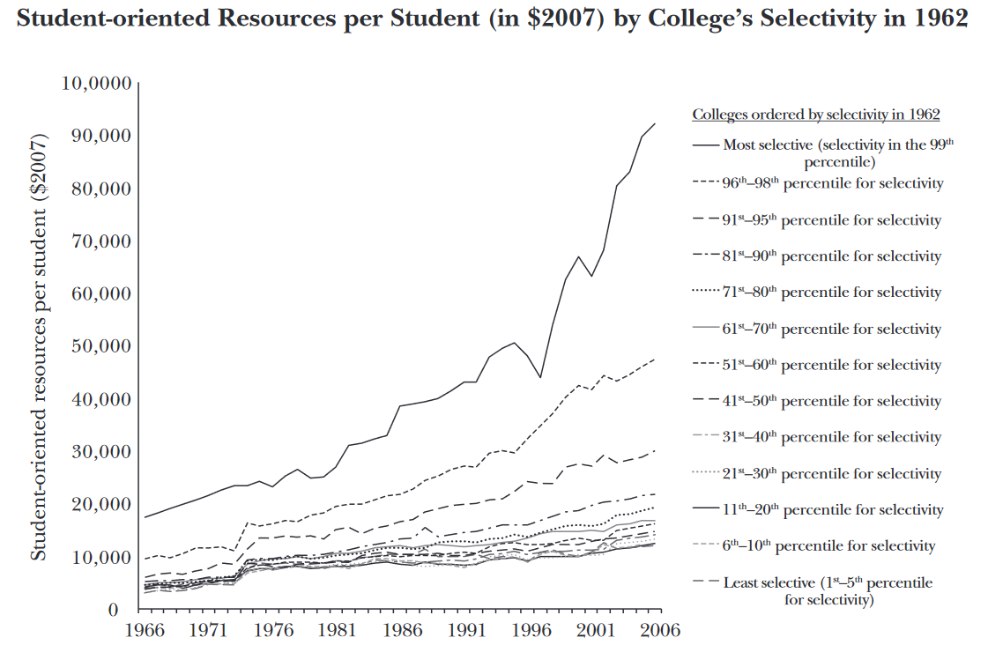
Gap Between “The Best” and “Rest” is Yawning
UPSHOT:
Better students cluster at better schools
Peer effects matter
Massively more spending per student at top schools
Richer, and better, schools, can provide more financial aid
Larger “Returns” to an Elite Education

Slide 25
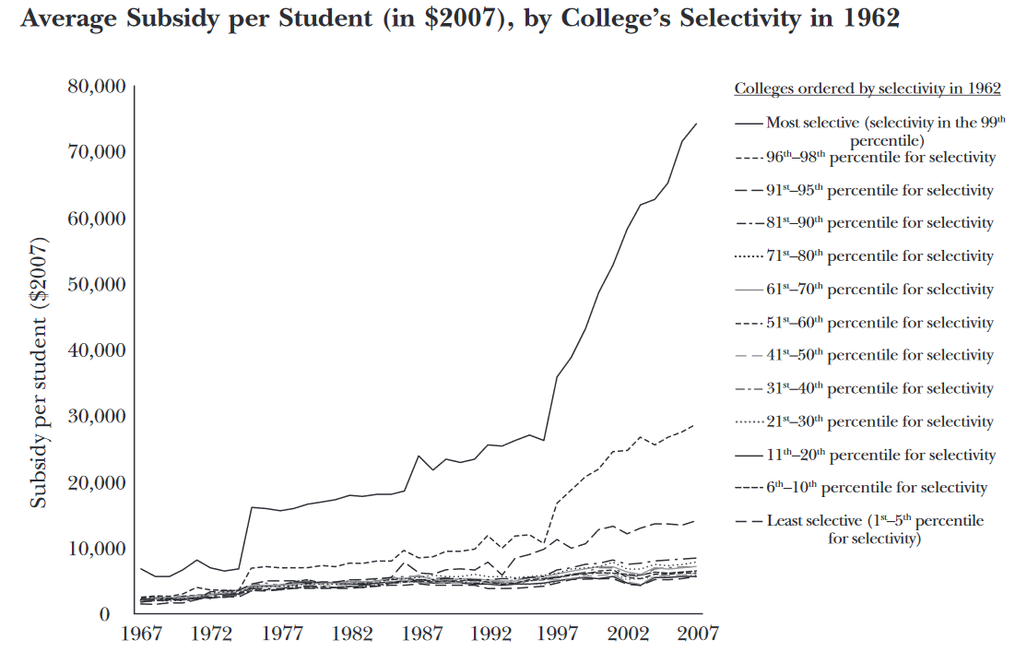
We See Quality Clustering (in Partners Too)
UPSHOT:
High-aptitude peers surround each other
Less cross-quality mixing, diversity
Spending gap top v. bottom rose from 4.5 to 7.7, and rising
Top 20 schools offer TRIPLE amount of subsidies as schools ranked 20-80 who are 60% richer than top 200

Slide 26
What Determines School Quality? $$$
Quality
Price Discrimination
Crafting a Class
More Quality

Slide 27
Upshot
Cost-Quality Gradient: What You Pay vs. What You Get falls as quality of school rises
Students at Top 100 Schools: Tuition payment is only 20% what the college spends on their education.
Students at 100th to 200th Schools: Tuition payment is 50% of what the college spends on their education.
Rethinking the “Cost” of College:

Slide 28
OK, OK, So Does It Pay to Attend an Elite School?
vs.
For fun: Harvard, the elites, and the origins of amateurism in college sports

Slide 29
Most Economic Evidence → YES
Hoekstra (2009):
Significant impact: annual returns > rate of return on equities.
Attending Flagship State U instead of Regional State U yields 20% larger earnings after graduation (for men only)
Black and Smith (2006):
Significant impact: Annual returns on quality > RR on equities.
Analyzed 14-21 year old males in 1979 (NLSY)
Examined several different measures of college quality including admissions rate, faculty-student ratio, retention rates, mean SAT score, faculty salaries

Slide 30
Most Economic Evidence → YES
Dale and Krueger (2002):
Compares kids who got into both UMASS & Harvard → huge returns
But, only 1 out of 10 kids who got into both Harvard and UMASS actually chose to go to UMASS.
Are they different in ways correlated with lifetime earnings?
Hoxby (2004)
Male college entrants in 1982
Clear benefit to attending a Top 50 school (an extra half-million of lifetime earnings over a “regular” school)

Slide 31
Most Economic Evidence → YES
Loury and Garman (1995):
Significant earnings advantage for all students, with returns for blacks larger than for whites
Students with low SAT scores at elite schools mismatch, and fail to complete college
Weinstein (2017):
Follows cohort of 10,000 students who are in B&B survey
Higher regional rank is more important that overall national rank
(e.g. Going to Texas-Austin as a Texan vs UVA on East Coast)
McKinsey Hiring at Tufts vs. Texas
But benefits do not persist after 10 years

Slide 32
Most Economic Evidence → YES
Dale and Krueger (2011):
Sizeable returns for Under-represented Minority Students
Particularly those with less-educated parents
Use College and Beyond Data
Tracks cohorts from Class of ‘76 and ‘89 at set of ~30 elite schools
Examines mean SAT score, Barron’s rating and net tuition as indicators of quality
Relationships nonlinear (e.g. 4 vs 9 is different than 37 vs. 41)
Coverage of paper overlooked other large impacts:
Attending higher Barron’s rated school and more expensive schools translated into enormous financial returns post-graduation
Ceteris paribus, students with SATs over 1100 earn less money
Also finds that athletes earn more money

Slide 33
Effect Sizes Are Large – My Best Guess at Summary
Illustration #1
Should I Attend My State’s Flagship vs. a Regional State School?
or
???
ANSWER: Go Bulls!
Earnings are 20% Larger a decade after graduating from Flagship
~ $13,000 more per year

Slide 34
Effect Sizes Are Large – My Best Guess at Summary
Illustration #2
Should I Attend School With Higher Average SAT Scores?
or
or
ANSWER: Go Green!
Every 100 points more → 7% higher earnings for URM
~ $4,550 more per year Dartmouth over Villanova
~ $9,100 more per year Rochester over Geneseo

Slide 35
Effect Sizes Are Large – My Best Guess at Summary
Illustration #3
Should I Attend School in More Selective Carnegie Classification?
or
or
ANSWER: Go Big!
Each category increases earnings by ~ $11,500
These are likely lower bound estimates
Within categories, earnings increases with SAT scores

Slide 36
Why Do I Sound So Uncertain?
What a Tangled Web
How can we disentangle the portion of the earnings premium that comes from “the Amherst effect” versus “the kid?”
What is the Secret Sauce?
If there IS an Amherst Effect, what is the mechanism?
Why Should You NOT Stop to Pick up a $100 Bill on NYC Sidewalk?
If it were really $100, it wouldn’t be there
These are enormous returns
Why isn’t competition frittering them away?
Undercounting the “real” costs of obtaining it (e.g. things like THIS talk!)

Slide 37
Why Do I Sound So Uncertain?
Is Past Prologue?
Even if previous cohorts enjoyed these advantages …
Will your children, graduating in 2025 and beyond, also enjoy it?
The gains seem to accrue with workplace experience
How does schooling interact with other institutions?
Not Just Financial Returns Matter
For example, my real wage is lower today than it was in 1997
I am also much happier
Need More Data
Not enough study tracking long-term outcomes for URM, females

Slide 38
Why Do I Sound So Uncertain?

Slide 39
Other Elite College Considerations
Think Beyond Financial Returns
Consumption value
Finishing school for the “elites”
Probability of graduate school admissions
Emotional, personal and character development

Slide 40
Other Elite College Considerations
Some Things They Don’t Tell You
Resource/amenity variances far smaller than earnings
Performance within schools vs. choosing top school
Research – Teaching tension, undergrad experience
Quality of faculty > Quality of school’s ranking
Cross subsidies everywhere
More, etc.

Slide 41
Caveat Emptor
Grain of Salt → Yours truly benefits when you send your children to elite colleges
Heterogeneity → Major matters, peers matter (sort of)
Completes vs. Attempts → Heckman et al. The “returns” to college cannot be ascertained merely from looking at students who graduate
Option Value → College is “risky” investment
Flotsam → Colleges as Elite Social Clubs

Slide 42
Thank You!
Call or text or email with questions/comments or to hear more.
Michael Rizzo
Department of Economics
University of Rochester
michael.rizzo@rochester.edu
585-478-2677

